Slide 1
MACHINE LEARNING ALGORITHMS
S.THENMALR

Slide 2
Module 2 - Design And Analysis of Machine Learning Algorithms
Guidelines for machine learning experiments
Cross Validation (CV) and resampling
Assessing a single classification algorithm and comparing two classification algorithms - K-fold CV Performance metrics-MSE, accuracy, confusion matrix, precision, recall, F1-score
Linear Regression
Logistic Regression with Binomial & Multi class classification
Dr.Maivizhi Assistant Professor / CINTEL

Slide 3
Module 2 - Design And Analysis of Machine Learning Algorithms
Guidelines for machine learning experiments
Formulate objectives.
Collect and preprocess data.
Split data into training, validation, and test sets (or use cross-validation).
Train the model with different algorithms and settings.
Evaluate performance using metrics relevant to the task.
Tune hyperparameters through cross-validation.
Perform error analysis to identify areas for improvement.
Select the best model and ensure it meets business goals and ethical standards.
Deploy the model, and monitor its performance over time.
Dr.Maivizhi Assistant Professor / CINTEL

Slide 4
Module 2 - Design And Analysis of Machine Learning Algorithms
Guidelines for machine learning experiments
Formulate objectives.
Collect and preprocess data
Data Cleaning: Handling missing data, removing outliers, fixing data inconsistencies.
Data Transformation: Normalizing or standardizing features to ensure that they have similar ranges or distributions.
Feature Engineering: Creating new features from the raw data to enhance model performance (e.g., combining features, deriving meaningful variables).
Encoding Categorical Variables: Converting categorical features to numerical ones using techniques like one-hot encoding or label encoding.
Handling Imbalanced Data: Techniques like SMOTE (Synthetic Minority Over-sampling Technique) or undersampling to balance datasets where one class is underrepresented.
Dr.Maivizhi Assistant Professor / CINTEL

Slide 5
Module 2 - Design And Analysis of Machine Learning Algorithms
Guidelines for machine learning experiments
Formulate objectives.
Collect and preprocess data.
Split data into training, validation, and test sets (or use cross-validation).
Train-Test Split: Dividing the dataset into training and testing sets (often 70%-80% training, 30%-20% testing).
K-Fold Cross Validation: Dividing the dataset into K equal parts to ensure the model is trained and validated on multiple sets, improving the robustness of the results.
Stratified K-Fold Cross Validation: Used when the dataset has imbalanced classes, ensuring that each fold maintains the same class distribution as the original dataset.
Dr.Maivizhi Assistant Professor / CINTEL

Slide 6
Module 2 - Design And Analysis of Machine Learning Algorithms
Guidelines for machine learning experiments
Formulate objectives.
Collect and preprocess data.
Split data into training, validation, and test sets (or use cross-validation).
Train the model with different algorithms and settings.
Baseline Models: Start with simple models (e.g., logistic regression, decision trees) to establish a performance baseline.
Algorithm Selection: Choose algorithms based on the type of problem (e.g., SVM for classification, CNN for images, RNN for sequences).
Ensemble Methods: Combining multiple models to improve accuracy, e.g., Bagging (Random Forest), Boosting (XGBoost, AdaBoost), Stacking.
Dr.Maivizhi Assistant Professor / CINTEL

Slide 7
Module 2 - Design And Analysis of Machine Learning Algorithms
Guidelines for machine learning experiments
Formulate objectives.
Collect and preprocess data.
Split data into training, validation, and test sets (or use cross-validation).
Train the model with different algorithms and settings.
Evaluate performance using metrics relevant to the task.
Accuracy: The percentage of correctly predicted instances.
Precision, Recall, F1-Score: Useful for classification tasks
ROC-AUC (Receiver Operating Characteristic - Area Under the Curve): Measures how well the model distinguishes between classes.
Confusion Matrix: Provides a detailed breakdown of model performance by showing true positives, false positives, true negatives, and false negatives.
Mean Squared Error (MSE) and Mean Absolute Error (MAE): For regression tasks, these evaluate how far off the predictions are from the actual values.
Dr.Maivizhi Assistant Professor / CINTEL

Slide 8
Module 2 - Design And Analysis of Machine Learning Algorithms
Guidelines for machine learning experiments
Formulate objectives.
Collect and preprocess data.
Split data into training, validation, and test sets (or use cross-validation).
Train the model with different algorithms and settings.
Evaluate performance using metrics relevant to the task.
Tune hyperparameters through cross-validation.
Grid Search: Systematically searching over a predefined hyperparameter space to find the best combination.
Random Search: Randomly selecting combinations of hyperparameters for faster tuning than Grid Search.
Bayesian Optimization: A more advanced method that uses probabilistic models to find the best hyperparameters efficiently.
Dr.Maivizhi Assistant Professor / CINTEL

Slide 9
Module 2 - Design And Analysis of Machine Learning Algorithms
Guidelines for machine learning experiments
Formulate objectives.
Collect and preprocess data.
Split data into training, validation, and test sets (or use cross-validation).
Train the model with different algorithms and settings.
Evaluate performance using metrics relevant to the task.
Tune hyperparameters through cross-validation.
Perform error analysis to identify areas for improvement.
Select the best model and ensure it meets business goals and ethical standards.
Deploy the model, and monitor its performance over time.
Dr.Maivizhi Assistant Professor / CINTEL

Slide 10

Cross Validation and Resampling
Cross Validation
Assess how well a machine learning model generalizes to an independent dataset.
Ensure that the model's performance is not due to overfitting or underfitting to a particular dataset.
It involves splitting the dataset into multiple subsets, training the model on some subsets, and testing it on others.
Design And Analysis of Machine Learning Algorithms

Slide 11
Cross Validation and Resampling
Cross Validation - Types
K-Fold Cross-Validation
Stratified K-Fold Cross-Validation
Leave-One-Out Cross-Validation
Leave-P-Out Cross-Validation
Repeated K-Fold Cross-Validation
Design And Analysis of Machine Learning Algorithms

Slide 12
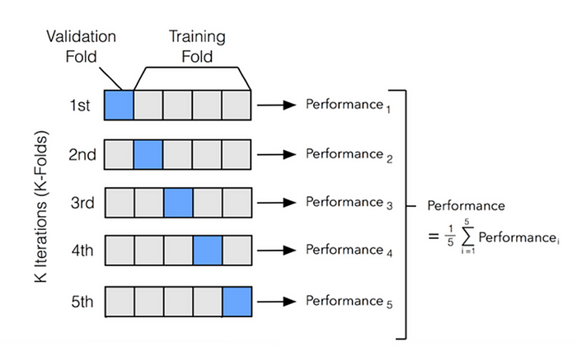
Cross Validation and Resampling
Cross Validation - Types
K-Fold Cross-Validation
The data is divided into K subsets (folds).
The model is trained on K-1 folds and tested on the remaining fold.
This is repeated K times with each fold being used as the validation set once.
The performance metric is averaged over all K runs to get the final estimate.
Design And Analysis of Machine Learning Algorithms

Slide 13
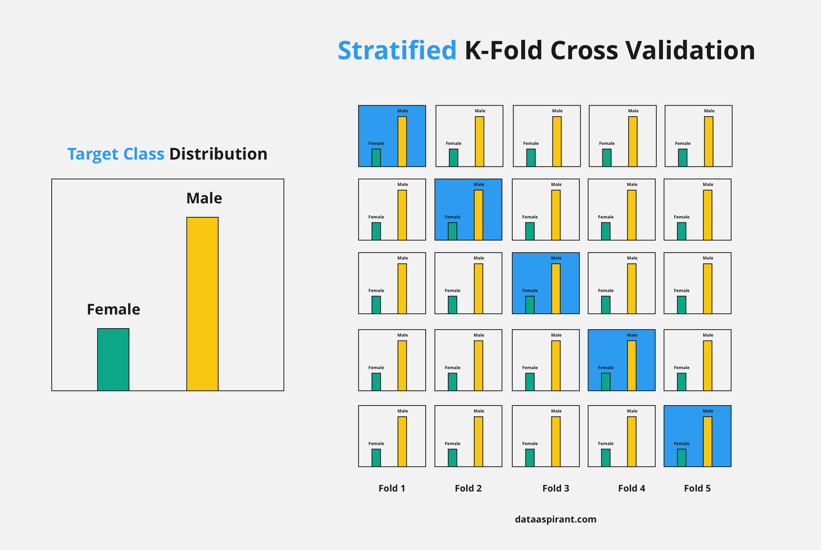
Cross Validation and Resampling
Cross Validation - Types
K-Fold Cross-Validation
Stratified K-Fold Cross-Validation
This is a variation of K-fold where the folds are stratified to ensure that the proportion of classes in each fold is similar to the original dataset.
Leave-One-Out Cross-Validation
Leave-P-Out Cross-Validation
Repeated K-Fold Cross-Validation
Design And Analysis of Machine Learning Algorithms

Slide 14
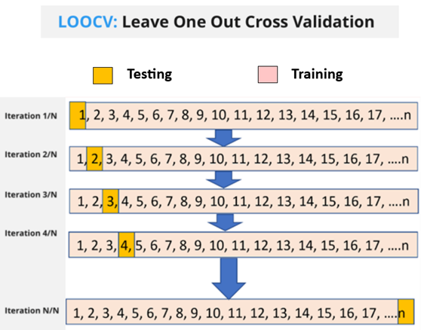
Cross Validation and Resampling
Cross Validation - Types
K-Fold Cross-Validation
Stratified K-Fold Cross-Validation
Leave-One-Out Cross-Validation
In each iteration, a single sample is used as the validation set, and the rest are used for training.
Leave-P-Out Cross-Validation
Repeated K-Fold Cross-Validation
Design And Analysis of Machine Learning Algorithms

Slide 15
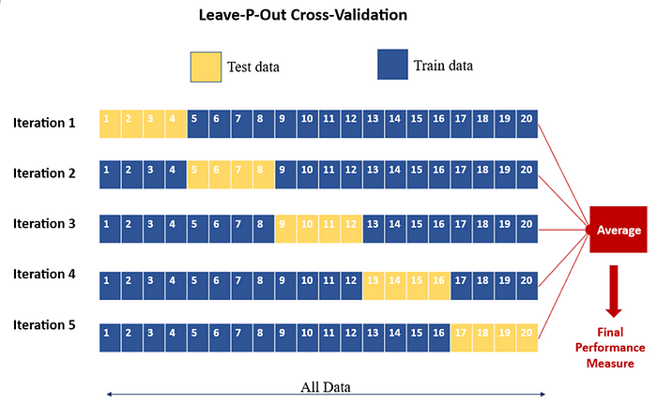
Cross Validation and Resampling
Cross Validation - Types
K-Fold Cross-Validation
Stratified K-Fold Cross-Validation
Leave-One-Out Cross-Validation
Leave-P-Out Cross-Validation
leaves P samples out of the training set in each iteration and uses them as the validation set
Repeated K-Fold Cross-Validation
Design And Analysis of Machine Learning Algorithms

Slide 16
Cross Validation and Resampling
Resampling
Create different samples from the data to estimate the properties of a model or dataset.
Types
Bootstrap Resampling
Monte Carlo Cross-Validation
Jackknife Resampling
Design And Analysis of Machine Learning Algorithms

Slide 17
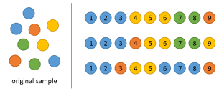
Cross Validation and Resampling
Resampling
Create different samples from the data to estimate the properties of a model or dataset.
Types
Bootstrap Resampling
The original dataset is sampled with replacement to create multiple “bootstrap” datasets.
Design And Analysis of Machine Learning Algorithms

Slide 18


Assessing a Single Classification Algorithm with K-Fold CV
Select the value of K: Common choices are K=5 or K=10. The higher the value, the better the estimate of the model’s performance, though it increases computational cost.
Perform Cross-Validation: Train the model K times, each time using different training and validation sets.
Record the performance metrics for each fold using any of the mentioned metrics (accuracy, precision, recall, etc.).
Aggregate Results: Calculate the mean and standard deviation of the performance metrics across all K folds to get a final estimate of how well the model performs on average.
Design And Analysis of Machine Learning Algorithms

Slide 19
Assessing a Single Classification Algorithm with K-Fold CV
Select the value of K: Common choices are K=5 or K=10. The higher the value, the better the estimate of the model’s performance, though it increases computational cost.
kfold = KFold(n_splits=5, shuffle=True, random_state=42)
Perform Cross-Validation: Train the model K times, each time using different training and validation sets.
Record the performance metrics for each fold using any of the mentioned metrics (accuracy, precision, recall, etc.).
model = SVC()
scoring = ['accuracy', 'precision_macro', 'recall_macro', 'f1_macro']
results = cross_validate(model, X, y, cv=kfold, scoring=scoring)
Aggregate Results: Calculate the mean and standard deviation of the performance metrics across all K folds to get a final estimate of how well the model performs on average.
Design And Analysis of Machine Learning Algorithms

Slide 20
Assessing a Single Classification Algorithm and comparing two Classification Algorithms
The procedure to be followed for two models
Select the value of K: Common choices are K=5 or K=10. The higher the value, the better the estimate of the model’s performance, though it increases computational cost.
Perform Cross-Validation: Train the model K times, each time using different training and validation sets.
Record the performance metrics for each fold using any of the mentioned metrics (accuracy, precision, recall, etc.).
Aggregate Results: Calculate the mean and standard deviation of the performance metrics across all K folds to get a final estimate of how well the model performs on average.
Design And Analysis of Machine Learning Algorithms

Slide 21
Assessing a Single Classification Algorithm and comparing two Classification Algorithms
Select the value of K: Common choices are K=5 or K=10. The higher the value, the better the estimate of the model’s performance, though it increases computational cost.
kfold = KFold(n_splits=5, shuffle=True, random_state=42)
Perform Cross-Validation: Train the model K times, each time using different training and validation sets.
Record the performance metrics for each fold using any of the mentioned metrics (accuracy, precision, recall, etc.).
model_1 = SVC() # Support Vector Classifier
model_2 = RandomForestClassifier() # Random Forest Classifier
scoring = ['accuracy', 'precision_macro', 'recall_macro', 'f1_macro']
results_model_1 = cross_validate(model_1, X, y, cv=kfold, scoring=scoring)
results_model_2 = cross_validate(model_2, X, y, cv=kfold, scoring=scoring)
Aggregate Results: Calculate the mean and standard deviation of the performance metrics across all K folds to get a final estimate of how well the model performs on average.
Design And Analysis of Machine Learning Algorithms

Slide 22
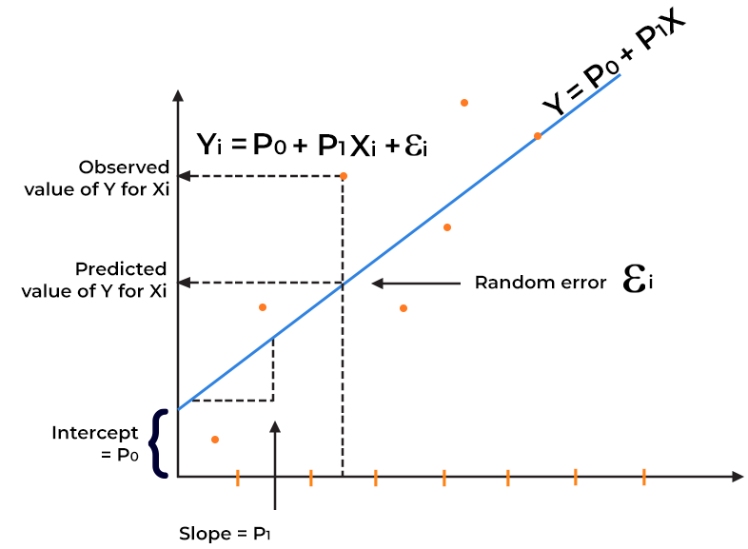
Linear Regression
Linear Regression is a supervised learning algorithm used for predicting a continuous dependent variable (target) based on one or more independent variables (features).
The goal is to find the best-fitting line that minimizes the error between predicted and actual values.
MLA – Session 2

Slide 23
Linear Regression
The general equation for a simple linear regression is:
𝑦=𝑚𝑥+𝑏
𝑦 is the dependent variable (target or response),
𝑥 is the independent variable (predictor or feature),
𝑚 is the slope of the line (how much 𝑦 changes for each unit change in 𝑥),
𝑏 is the intercept (the value of 𝑦 when 𝑥=0).
Example Scenario: Predicting House Prices
MLA – Session 2

Slide 24
Linear Regression
Predicting House Prices
House Size (Sq ft) x | House Price ($) y
500 | 150,000
800 | 200,000
1000 | 250,000
1200 | 280,000
1500 | 320,000
MLA – Session 2

Slide 25
Linear Regression
Predicting House Prices
House Size (Sq ft) x | House Price ($) y
500 | 150,000
800 | 200,000
1000 | 250,000
1200 | 280,000
1500 | 320,000
MLA – Session 2

Slide 26
Linear Regression
Predicting House Prices
House Size (Sq ft) x | House Price ($) y
500 | 150,000
800 | 200,000
1000 | 250,000
1200 | 280,000
1500 | 320,000
𝑦=𝑚𝑥+𝑏
MLA – Session 2

Slide 27
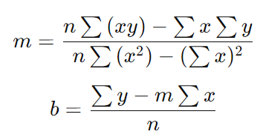
Linear Regression
Predicting House Prices
House Size (Sq ft) x | House Price ($) y
500 | 150,000
800 | 200,000
1000 | 250,000
1200 | 280,000
1500 | 320,000
𝑦=𝑚𝑥+𝑏
MLA – Session 2

Slide 28
Linear Regression
Predicting House Prices
House Size (Sq ft) x | House Price ($) y
500 | 150,000
800 | 200,000
1000 | 250,000
1200 | 280,000
1500 | 320,000
𝑦=𝑚𝑥+𝑏
MLA – Session 2

Slide 29
Linear Regression
Predicting House Prices
House Size (Sq ft) x | House Price ($) y
500 | 150,000
800 | 200,000
1000 | 250,000
1200 | 280,000
1500 | 320,000
𝑦=𝑚𝑥+𝑏
House Size (Sq ft) x | House Price ($) y | x*y | x*x
500 | 150,000
800 | 200,000
1000 | 250,000
1200 | 280,000
1500 | 320,000
MLA – Session 2

Slide 30
Linear Regression
Predicting House Prices
House Size (Sq ft) x | House Price ($) y
500 | 150,000
800 | 200,000
1000 | 250,000
1200 | 280,000
1500 | 320,000
𝑦=𝑚𝑥+𝑏
House Size (Sq ft) x | House Price ($) y | x*y | x*x
500 | 150,000 | 75,000,000 | 250,000
800 | 200,000 | 160,000,000 | 640,000
1000 | 250,000 | 250,000,000 | 1,000,000
1200 | 280,000 | 336,000,000 | 1,440,000
1500 | 320,000 | 480,000,000 | 2,250,000
MLA – Session 2

Slide 31
Linear Regression
Predicting House Prices
House Size (Sq ft) x | House Price ($) y
500 | 150,000
800 | 200,000
1000 | 250,000
1200 | 280,000
1500 | 320,000
𝑦=𝑚𝑥+𝑏
House Size (Sq ft) x | House Price ($) y | x*y | x*x
500 | 150,000 | 75,000,000 | 250,000
800 | 200,000 | 160,000,000 | 640,000
1000 | 250,000 | 250,000,000 | 1,000,000
1200 | 280,000 | 336,000,000 | 1,440,000
1500 | 320,000 | 480,000,000 | 2,250,000
5000 | 1200000 | 1301000000 | 5580000
MLA – Session 2

Slide 32
Linear Regression
Predicting House Prices
House Size (Sq ft) x | House Price ($) y
500 | 150,000
800 | 200,000
1000 | 250,000
1200 | 280,000
1500 | 320,000
y=174.14x+65,860
House Size (Sq ft) x | House Price ($) y | x*y | x*x
500 | 150,000 | 75,000,000 | 250,000
800 | 200,000 | 160,000,000 | 640,000
1000 | 250,000 | 250,000,000 | 1,000,000
1200 | 280,000 | 336,000,000 | 1,440,000
1500 | 320,000 | 480,000,000 | 2,250,000
5000 | 1200000 | 1301000000 | 5580000
MLA – Session 2

Slide 33
Linear Regression
Predicting House Prices
House Size (Sq ft) x | House Price ($) y
500 | 150,000
800 | 200,000
1000 | 250,000
1200 | 280,000
1500 | 320,000
y=174.14x+65,860
House Size (Sq ft) x | House Price ($) y | x*y | x*x
500 | 150,000 | 75,000,000 | 250,000
800 | 200,000 | 160,000,000 | 640,000
1000 | 250,000 | 250,000,000 | 1,000,000
1200 | 280,000 | 336,000,000 | 1,440,000
1500 | 320,000 | 480,000,000 | 2,250,000
5000 | 1200000 | 1301000000 | 5580000
Slope (m = 174.14): For each additional square foot of house size, the price is expected to increase by approximately $174.14.
Intercept (b = 65,860): Even if the house size is 0 square feet, the model predicts a base price of around $65,860 (though this may not have practical meaning in this context).
MLA – Session 2

Slide 34

Linear Regression
Predicting House Prices
House Size (Sq ft) x | House Price ($) y
500 | 150,000
800 | 200,000
1000 | 250,000
1200 | 280,000
1500 | 320,000
y=174.14x+65,860
House Size (Sq ft) x | House Price ($) y | x*y | x*x
500 | 150,000 | 75,000,000 | 250,000
800 | 200,000 | 160,000,000 | 640,000
1000 | 250,000 | 250,000,000 | 1,000,000
1200 | 280,000 | 336,000,000 | 1,440,000
1500 | 320,000 | 480,000,000 | 2,250,000
5000 | 1200000 | 1301000000 | 5580000
Make predictions -- For a house of size 1100 square feet
MLA – Session 2

Slide 35
Linear Regression
Predicting House Prices
House Size (Sq ft) x | House Price ($) y
500 | 150,000
800 | 200,000
1000 | 250,000
1200 | 280,000
1500 | 320,000
y=174.14x+65,860
House Size (Sq ft) x | House Price ($) y | x*y | x*x
500 | 150,000 | 75,000,000 | 250,000
800 | 200,000 | 160,000,000 | 640,000
1000 | 250,000 | 250,000,000 | 1,000,000
1200 | 280,000 | 336,000,000 | 1,440,000
1500 | 320,000 | 480,000,000 | 2,250,000
5000 | 1200000 | 1301000000 | 5580000
Make predictions -- For a house of size 1100 square feet
y=174.14×1100+65,860=191,554+65,860=257,414
MLA – Session 2

Slide 36
Linear Regression
Predicting House Prices
House Size (Sq ft) x | House Price ($) y
500 | 150,000
800 | 200,000
1000 | 250,000
1200 | 280,000
1500 | 320,000
y=174.14x+65,860
House Size (Sq ft) x | House Price ($) y | x*y | x*x
500 | 150,000 | 75,000,000 | 250,000
800 | 200,000 | 160,000,000 | 640,000
1000 | 250,000 | 250,000,000 | 1,000,000
1200 | 280,000 | 336,000,000 | 1,440,000
1500 | 320,000 | 480,000,000 | 2,250,000
5000 | 1200000 | 1301000000 | 5580000
Make predictions -- For a house of size 1100 square feet
y=174.14×1100+65,860=191,554+65,860=257,414
evaluation metrics like Mean Squared Error (MSE) or R-squared
MLA – Session 2

Slide 37
Summary of Linear Regression
Collect and prepare the data (identify dependent and independent variables)
Plot the data to visualize the relationship
Fit the linear regression model by calculating the slope (𝑚) and intercept (𝑏)
Interpret the model to understand the relationship between variables
Make predictions using the regression equation
Evaluate the model's performance using appropriate metrics
Dr.Maivizhi Assistant Professor / CINTEL

Slide 38
Logistic Regression
Logistic regression is a machine learning algorithm used to predict the probability that an observation belongs to one of two possible classes.
Build an email classifier to tell us whether an incoming email should be marked as “spam” or “not spam”.
Check radiological images to predict whether a tumor is benign or malignant.
Historic bank records to predict whether a customer will default on their loan repayments or repay the loan.
Design And Analysis of Machine Learning Algorithms
Notes:
We train the model by feeding it input data and a binary class to which this data belongs.
For example, we would input the email subject line (“A Nigerian prince needs your help”) into the model with the accompanying class (“spam”). The model learns the patterns between the incoming data and the desired output as a mapping (aka, when input is “x”, predict “y”).
The logistic regression can then be used on novel input data which the model has never seen before (during training).

Slide 39
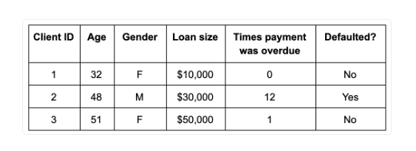
Logistic Regression - Example
Predict whether or not a client of your bank will default on their loan repayments.
The data would contain client demographic information (e.g. age, gender, location, etc.), their financial information (loan size, times that payment was overdue, etc.), and whether they ended up defaulting on a loan or repaying it.
Design And Analysis of Machine Learning Algorithms

Slide 40
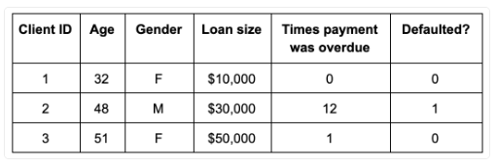
Logistic Regression - Example
Predict whether or not a client of your bank will default on their loan repayments.
The data would contain client demographic information (e.g. age, gender, location, etc.), their financial information (loan size, times that payment was overdue, etc.), and whether they ended up defaulting on a loan or repaying it.
Design And Analysis of Machine Learning Algorithms

Slide 41
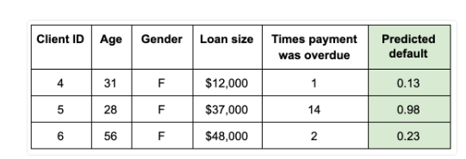
Logistic Regression - Example
Predict whether or not a client of your bank will default on their loan repayments.
The data would contain client demographic information (e.g. age, gender, location, etc.), their financial information (loan size, times that payment was overdue, etc.), and whether they ended up defaulting on a loan or repaying it.
Assess the performance of models or systems
Design And Analysis of Machine Learning Algorithms

Slide 42
Logistic Regression
Logistic regression is a supervised machine learning classification algorithm
Supervised machine learning: supervised learning techniques train the model by providing pairs of input-output examples from which it can learn. For example, the logistic regression would learn from a specific example to associate three missed loan repayments with future default (class membership = 1).
Classification algorithm: the purpose of the machine learning model is to classify examples into distinct (binary) classes. For instance, default vs. paying loans, email classification as spam or not spam
Design And Analysis of Machine Learning Algorithms

Slide 43
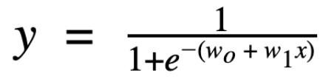
Logistic Regression
The model takes the form of a logistic regression equation:
y is the predicted probability of belonging to the default class.
In binary classification, we mark the default class with 1 and the other class with 0.
y states the probability of an example belonging to the default class on a scale from 0 to 1 (exclusive).
So y=0.99 would mean that the model predicts the example belonging to class 1.
During training, y is also called the target variable in machine learning, or the dependent variable in statistical modeling. It represents the categorical value that we are trying to predict.
1/(1+e^-z) is the sigmoid function.
wo + w1x is the linear model within logistic regression.
Design And Analysis of Machine Learning Algorithms

Slide 44
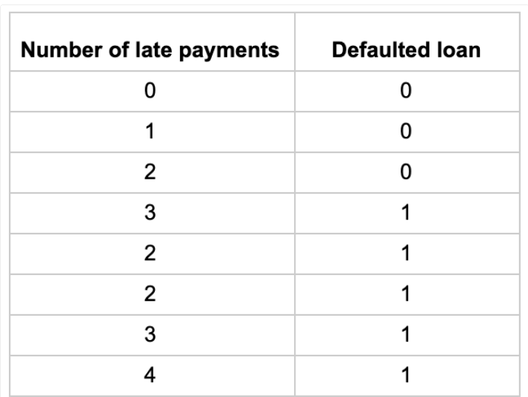
Logistic Regression
We could model the data with a linear regression
Design And Analysis of Machine Learning Algorithms

Slide 45
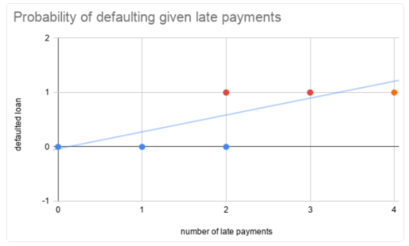
Logistic Regression
We could model the data with a linear regression
Design And Analysis of Machine Learning Algorithms

Slide 46
Logistic Regression
We could model the data with a linear regression
For a certain number of late payments (two in this example), it is unclear whether we should categorize them under non-defaulting or defaulting behavior
Design And Analysis of Machine Learning Algorithms

Slide 47
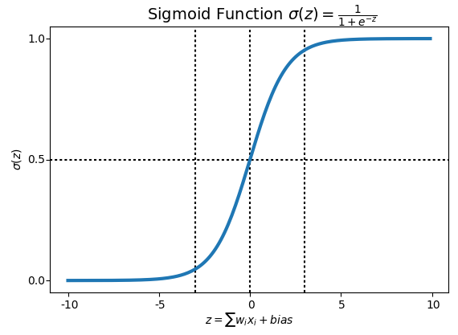
Logistic Regression
Sigmoid function
The sigmoid function is a function that produces an s-shaped curve.
It takes any real value as an argument and maps it to a range between 0 and 1 (exclusive).
Design And Analysis of Machine Learning Algorithms

Slide 48
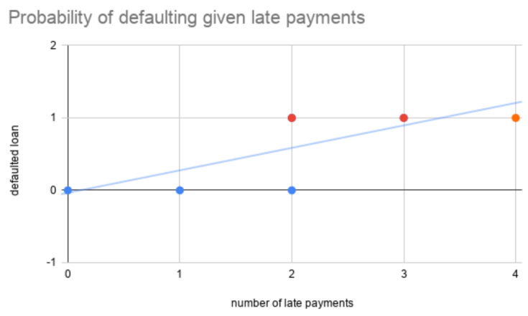
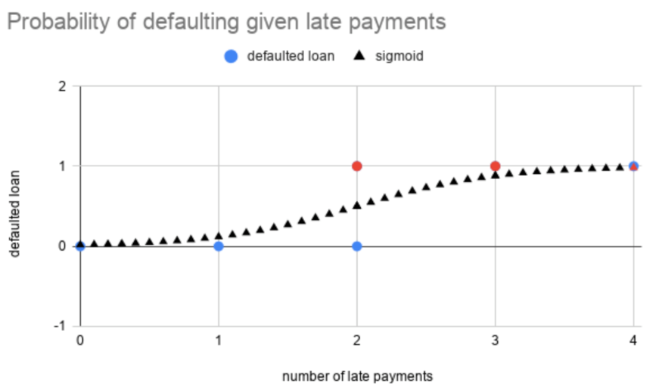
Logistic Regression
Sigmoid function
The sigmoid function is a function that produces an s-shaped curve.
It takes any real value as an argument and maps it to a range between 0 and 1 (exclusive).
y = 0 if predicted probability < 0.5
y = 1 if predicted probability > 0.5
Design And Analysis of Machine Learning Algorithms

Slide 49

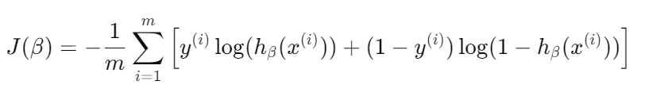
Logistic Regression
Initialization:
Start with an initial guess of the model parameters 𝛽0,𝛽1,…,𝛽𝑛
Hypothesis:
Log-odds of the probability of an event (class 1) is a linear function of the input features.
Cost Function (Log Loss):
The cost function used in logistic regression is based on maximum likelihood estimation (MLE).
Design And Analysis of Machine Learning Algorithms

Slide 50


Logistic Regression
Gradient Descent:
The parameters 𝛽0,𝛽1,…,𝛽𝑛 are updated using gradient descent to minimize the cost function.
The updates are made iteratively as follows:
Model Prediction:
After training, the model can make predictions for new inputs by calculating the probability 𝑃(𝑦=1∣𝑋).
The final classification is made by applying a threshold (typically 0.5):
If 𝑃(𝑦=1∣𝑋)≥0.5 classify as class 1.
If 𝑃(𝑦=1∣𝑋)<0.5, classify as class 0.
Design And Analysis of Machine Learning Algorithms

Slide 51




Logistic Regression
Performance Metrics
Accuracy
Precision
Recall (Sensitivity)
f1-score
Design And Analysis of Machine Learning Algorithms

Slide 52
Logistic Regression
Performance Metrics
Accuracy
Precision
Recall (Sensitivity)
f1-score
ROC-AUC Score: The area under the Receiver Operating Characteristic curve. It measures the model’s ability to distinguish between classes.
Confusion Matrix: A table that shows the counts of true positives, true negatives, false positives, and false negatives.
Design And Analysis of Machine Learning Algorithms

Slide 53
Logistic Regression - Multi class classification
Logistic regression is used for binary classification, it can be extended to handle multi-class classification problems.
In the case of multi-class classification, the goal is to assign an observation to one of three or more classes.
This is achieved using techniques such as One-vs-Rest (OvR) or Softmax (Multinomial Logistic Regression)
Design And Analysis of Machine Learning Algorithms

Slide 54
Logistic Regression - Multi class classification
One-vs-Rest (OvR) / One-vs-All (OvA)
In this approach, the multi-class classification problem is converted into multiple binary classification problems.
For K classes, you create K separate binary classifiers, one for each class.
Each classifier is trained to distinguish one class (positive) from all other classes (negative).
During prediction, all classifiers are evaluated, and the one with the highest confidence (probability) is chosen as the final prediction.
Design And Analysis of Machine Learning Algorithms

Slide 55
Logistic Regression - Multi class classification
One-vs-Rest (OvR) / One-vs-All (OvA)
In a multiclass classification task, you have more than two classes to predict.
For example, consider a problem where you need to classify iris flowers into three classes: Setosa, Versicolor, and Virginica.
For each class, you create a separate binary classifier.
This means that if you have 𝐶 classes, you will build 𝐶 binary classifiers.
Each classifier is trained to distinguish between one class (the positive class) and all the other classes combined (the negative class).
Design And Analysis of Machine Learning Algorithms

Slide 56
Logistic Regression - Multi class classification
One-vs-Rest (OvR) / One-vs-All (OvA)
For each class 𝑐_{𝑖}​
The data points of class 𝑐_{𝑖}​ are treated as positive examples.
All other class data points are treated as negative examples.
Train a binary classifier using these positive and negative examples.
For example, if you have three classes
Classifier 1 (for Setosa): Positive = Setosa, Negative = Versicolor + Virginica
Classifier 2 (for Versicolor): Positive = Versicolor, Negative = Setosa + Virginica
Classifier 3 (for Virginica): Positive = Virginica, Negative = Setosa + Versicolor
Design And Analysis of Machine Learning Algorithms

Slide 57
Logistic Regression - Multi class classification
One-vs-Rest (OvR) / One-vs-All (OvA)
To make a prediction for a new sample, each of the trained binary classifiers will output a score or a probability indicating how likely it is that the sample belongs to the corresponding class.
The class with the highest score (or probability) across all classifiers is chosen as the predicted class for that sample.
Each classifier gives you the following scores
Classifier for Setosa: Score = 0.8
Classifier for Versicolor: Score = 0.6
Classifier for Virginica: Score = 0.4
The predicted class will be Setosa since it has the highest score (0.8).
Design And Analysis of Machine Learning Algorithms

Slide 58
Logistic Regression - Multi class classification
One-vs-Rest (OvR) / One-vs-All (OvA)
To make a prediction for a new sample, each of the trained binary classifiers will output a score or a probability indicating how likely it is that the sample belongs to the corresponding class.
The class with the highest score (or probability) across all classifiers is chosen as the predicted class for that sample.
Each classifier gives you the following scores
Classifier for Setosa: Score = 0.8
Classifier for Versicolor: Score = 0.6
Classifier for Virginica: Score = 0.4
The predicted class will be Setosa since it has the highest score (0.8).
One-vs-Rest is a robust method for handling multiclass classification by converting it into multiple binary classification tasks
Design And Analysis of Machine Learning Algorithms

Slide 59

Logistic Regression - Multi class classification
Softmax Regression (Multinomial Logistic Regression)
This is a more natural extension of logistic regression for multi-class problems.
Instead of training K binary classifiers, you train a single model that directly predicts the probability distribution over the K classes.
The model uses the softmax function to generalize the logistic regression model to multiple classes.
The softmax function ensures that the predicted probabilities for all classes sum to 1.
Design And Analysis of Machine Learning Algorithms
Notes:
The softmax function is used to convert the raw output (logits) from the linear regression model into probabilities for each class. For a given input XXX, the probability of class kkk is given by:

Slide 60
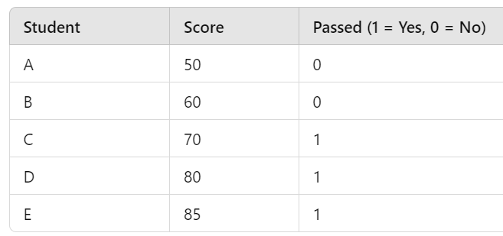
Logistic Regression – Work out Example
Predict Whether a Student Passes an Exam
The logistic regression model predicts the probability of passing based on the score. The logistic regression coefficient for the model is are given as :
z=β0+β1×Score
Where:
β0=−8.5
β1=0.1
Now, your task is to calculate the probability of passing for a student who scored 75.
Design And Analysis of Machine Learning Algorithms
Notes:
The softmax function is used to convert the raw output (logits) from the linear regression model into probabilities for each class. For a given input XXX, the probability of class kkk is given by:

Slide 61

Logistic Regression – Work out Example
Calculate the linear combination (log-odds) using the logistic regression equation
Design And Analysis of Machine Learning Algorithms
Notes:
The softmax function is used to convert the raw output (logits) from the linear regression model into probabilities for each class. For a given input XXX, the probability of class kkk is given by:

Slide 62

Logistic Regression – Work out Example
Calculate the linear combination (log-odds) using the logistic regression equation
Design And Analysis of Machine Learning Algorithms
Notes:
The softmax function is used to convert the raw output (logits) from the linear regression model into probabilities for each class. For a given input XXX, the probability of class kkk is given by:

Slide 63

Logistic Regression – Work out Example
Calculate the linear combination (log-odds) using the logistic regression equation
Design And Analysis of Machine Learning Algorithms
Notes:
The softmax function is used to convert the raw output (logits) from the linear regression model into probabilities for each class. For a given input XXX, the probability of class kkk is given by:

Slide 64
Logistic Regression – Work out Example
Calculate the linear combination (log-odds) using the logistic regression equation
So the log-odds, z = -1
Design And Analysis of Machine Learning Algorithms
Notes:
The softmax function is used to convert the raw output (logits) from the linear regression model into probabilities for each class. For a given input XXX, the probability of class kkk is given by:

Slide 65
Logistic Regression – Work out Example
Calculate the linear combination (log-odds) using the logistic regression equation
So the log-odds, z = -1
Apply the logistic (sigmoid) function to calculate the probability
Design And Analysis of Machine Learning Algorithms
Notes:
The softmax function is used to convert the raw output (logits) from the linear regression model into probabilities for each class. For a given input XXX, the probability of class kkk is given by:

Slide 66
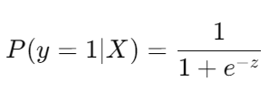
Logistic Regression – Work out Example
Calculate the linear combination (log-odds) using the logistic regression equation
So the log-odds, z = -1
Apply the logistic (sigmoid) function to calculate the probability
Design And Analysis of Machine Learning Algorithms
Notes:
The softmax function is used to convert the raw output (logits) from the linear regression model into probabilities for each class. For a given input XXX, the probability of class kkk is given by:

Slide 67

Logistic Regression – Work out Example
Calculate the linear combination (log-odds) using the logistic regression equation
So the log-odds, z = -1
Apply the logistic (sigmoid) function to calculate the probability
Design And Analysis of Machine Learning Algorithms
Notes:
The softmax function is used to convert the raw output (logits) from the linear regression model into probabilities for each class. For a given input XXX, the probability of class kkk is given by:

Slide 68

Logistic Regression – Work out Example
Calculate the linear combination (log-odds) using the logistic regression equation
So the log-odds, z = -1
Apply the logistic (sigmoid) function to calculate the probability
Design And Analysis of Machine Learning Algorithms
Notes:
The softmax function is used to convert the raw output (logits) from the linear regression model into probabilities for each class. For a given input XXX, the probability of class kkk is given by:

Slide 69

Logistic Regression – Work out Example
Calculate the linear combination (log-odds) using the logistic regression equation
So the log-odds, z = -1
Apply the logistic (sigmoid) function to calculate the probability
Design And Analysis of Machine Learning Algorithms
Notes:
The softmax function is used to convert the raw output (logits) from the linear regression model into probabilities for each class. For a given input XXX, the probability of class kkk is given by:

Slide 70

Logistic Regression – Work out Example
Calculate the linear combination (log-odds) using the logistic regression equation
So the log-odds, z = -1
Apply the logistic (sigmoid) function to calculate the probability
Design And Analysis of Machine Learning Algorithms
Notes:
The softmax function is used to convert the raw output (logits) from the linear regression model into probabilities for each class. For a given input XXX, the probability of class kkk is given by:

Slide 71
Logistic Regression – Work out Example
Calculate the linear combination (log-odds) using the logistic regression equation
So the log-odds, z = -1
Apply the logistic (sigmoid) function to calculate the probability
Interpret the result: Compare the probability with a threshold of 0.5 to decide whether the student will pass the exam
Design And Analysis of Machine Learning Algorithms
Notes:
The softmax function is used to convert the raw output (logits) from the linear regression model into probabilities for each class. For a given input XXX, the probability of class kkk is given by:

Slide 72

Logistic Regression – Work out Example
Predict Whether a Student Passes an Exam
The logistic regression model predicts the probability of passing based on the score. The logistic regression coefficient for the model is are given as :
z=β0+β1×Score
Where:
β0=−8.5
β1=0.1
Now, your task is to calculate the probability of passing for a student who scored 90.
Design And Analysis of Machine Learning Algorithms
Notes:
The softmax function is used to convert the raw output (logits) from the linear regression model into probabilities for each class. For a given input XXX, the probability of class kkk is given by:

Slide 73
Recap
Guidelines for machine learning experiments
Cross Validation (CV) and resampling
K-fold CV, measuring classifier performance
Assessing a single classification algorithm
comparing two classification algorithms
Logistic Regression with Binomial & Multi class classification

Slide 74
Questions
Define cross validation and resampling
Differentiate between k fold cross validation and stratified cross validation
Explain the Logistic Regression
Differentiate the Logistic and Linear Regression
Enumerate the methods used to identify multi class classification
Discuss the guidelines followed for the machine learning experiments with the suitable techniques
Suggest the procedures for the comparison of two classification algorithms
Describe any four strategies adapted for cross validation

